Slide 1
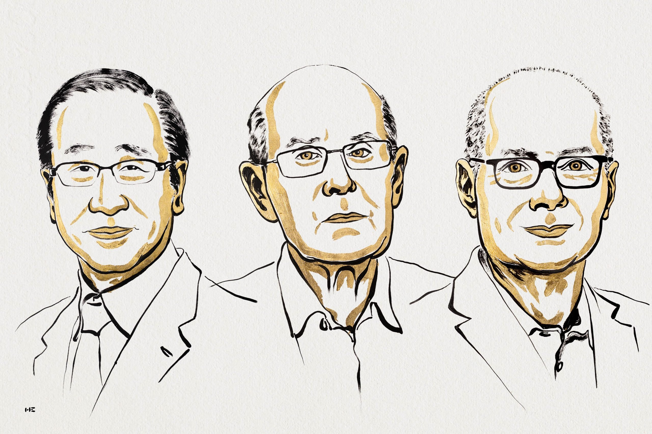
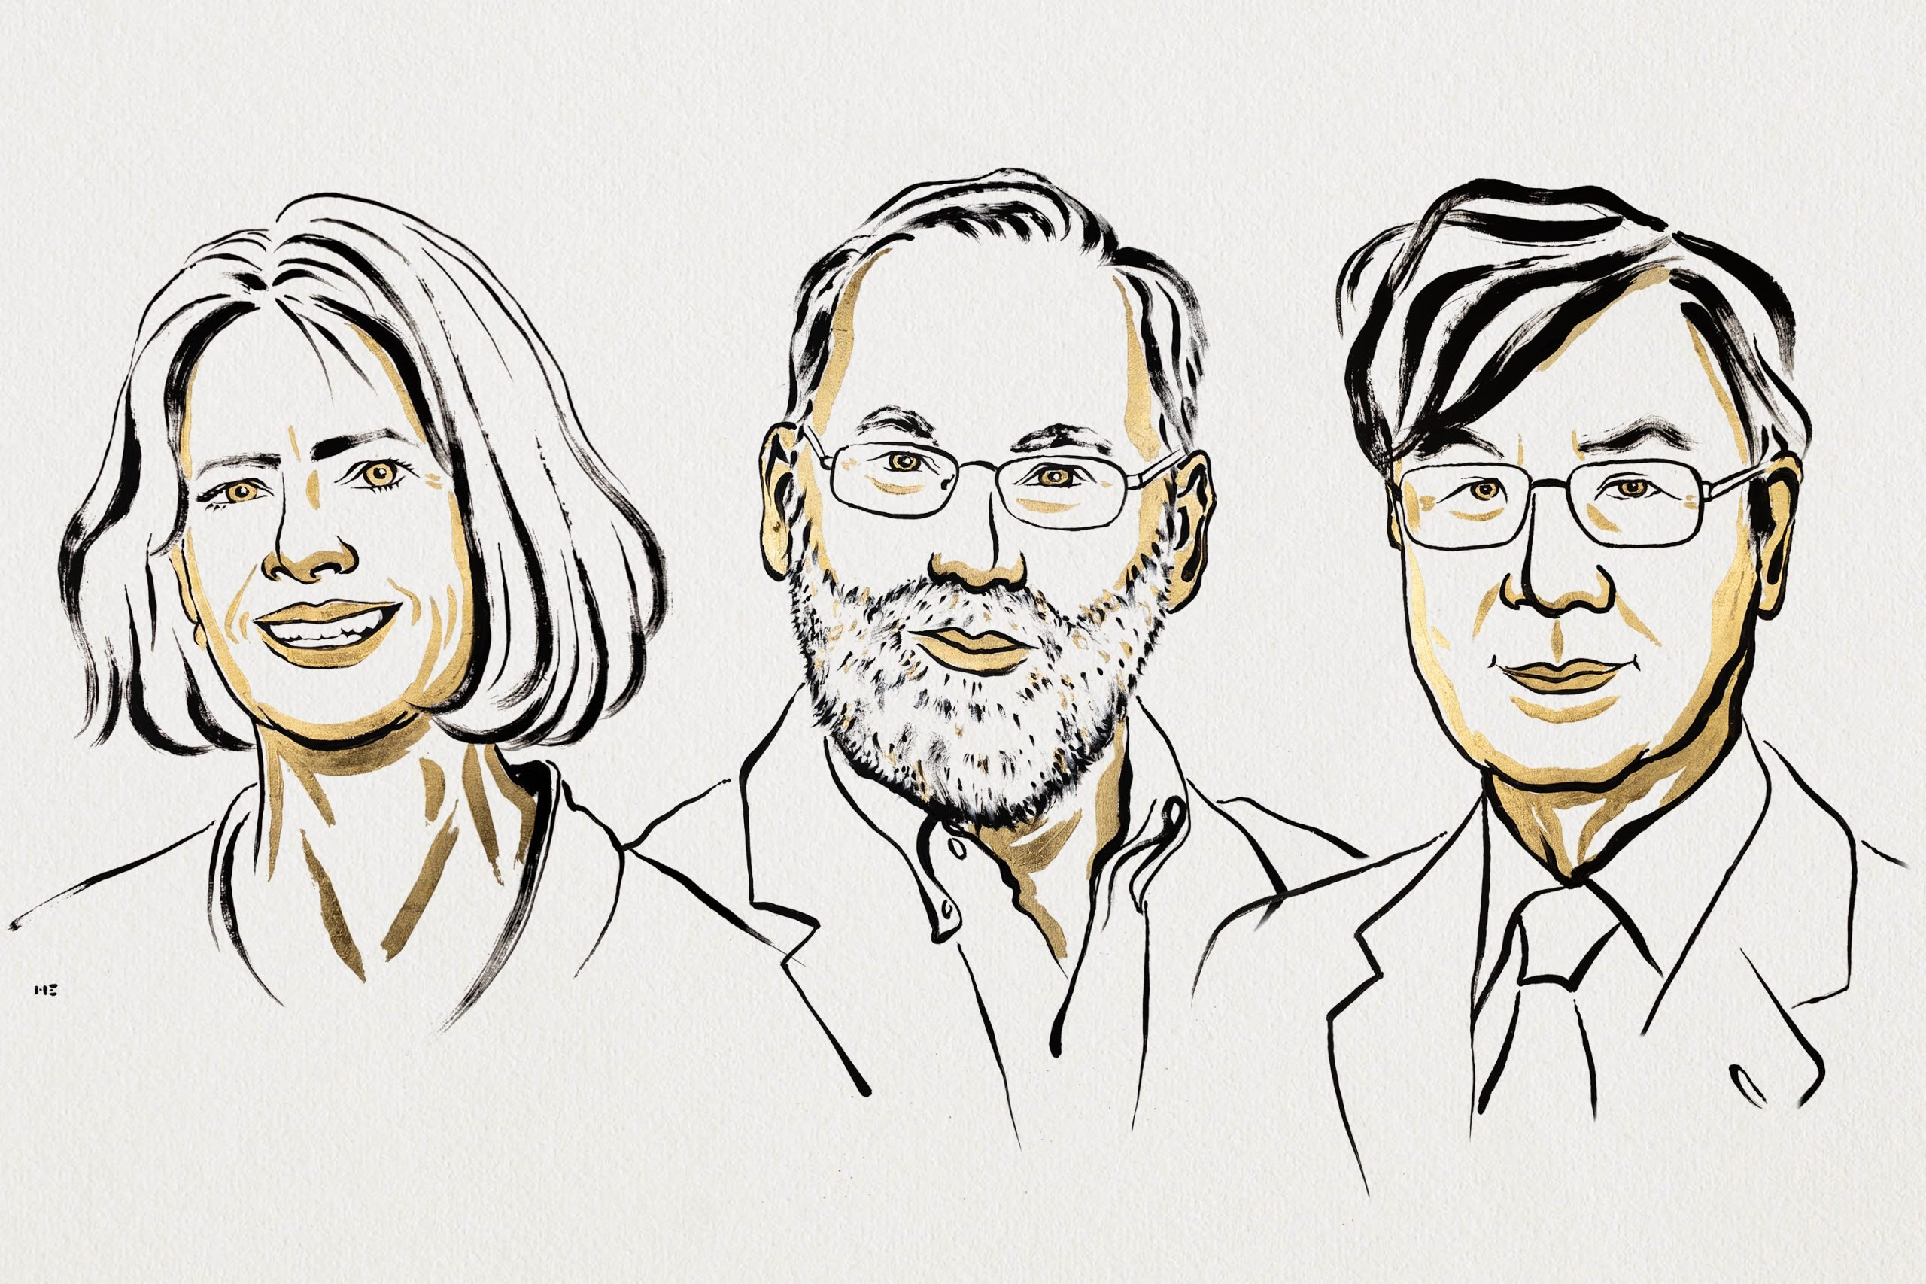
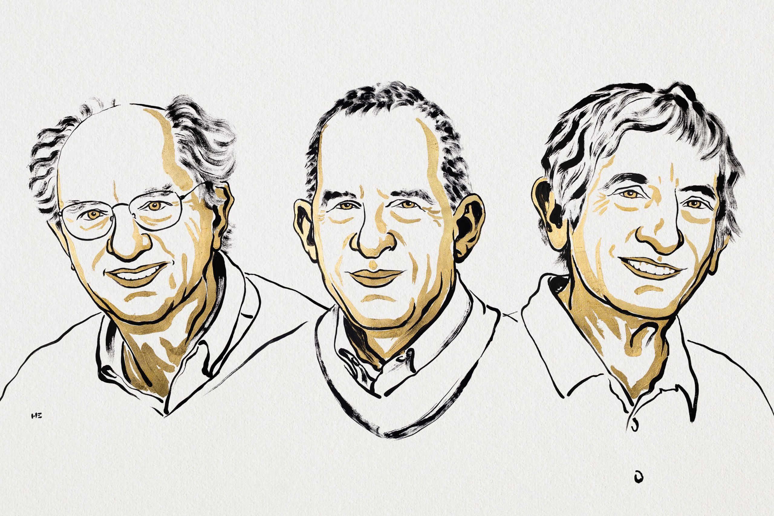
2025 Nobel Prizes!
Chemistry
Susumu Kitagawa, Richard Robson, and Omar M. Yaghi - “for the development of metal–organic frameworks.”
Physiology or Medicine
Mary E. Brunkow, Fred Ramsdell, and Shimon Sakaguchi - “for their discoveries concerning peripheral immune tolerance.”
Physics
John Clarke, Michel H. Devoret, and John M. Martinis - “for the discovery of macroscopic quantum mechanical tunnelling and energy quantisation in an electric circuit.”

Slide 2
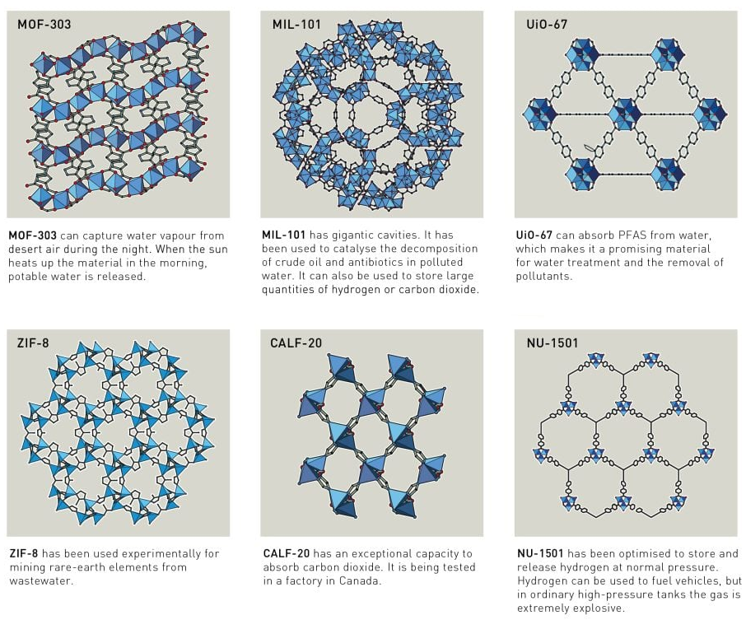
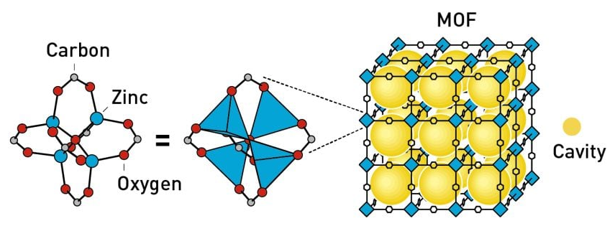
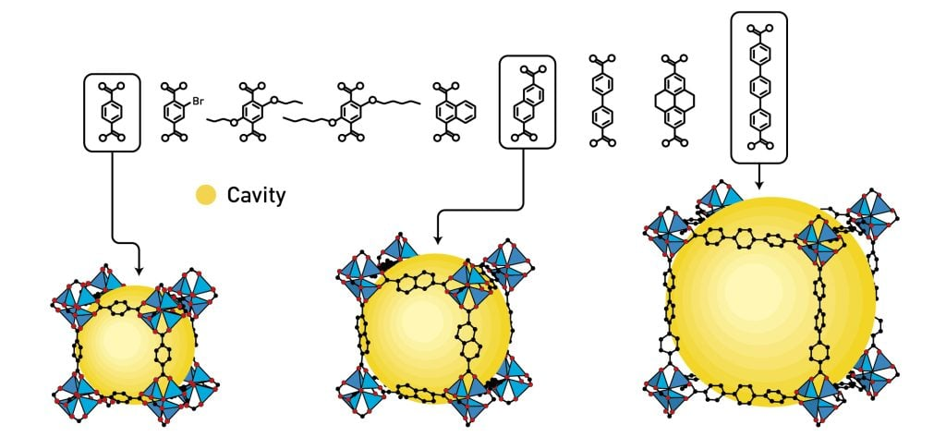
Metal-Organic Frameworks
Metal–Organic Frameworks (MOFs): Contain large cavities in which molecules can flow in and out.
Can be used to harvest water from desert air, extract pollutants from water, capture carbon dioxide and store hydrogen.

Slide 3
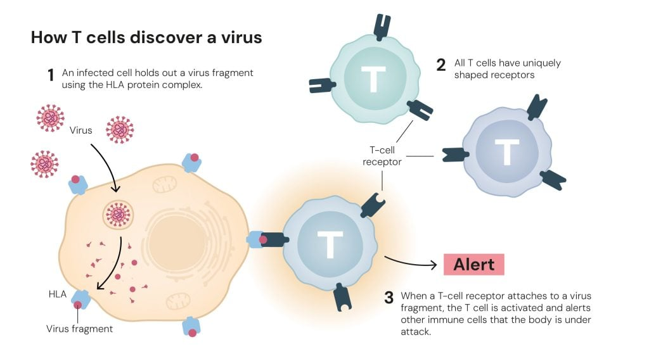
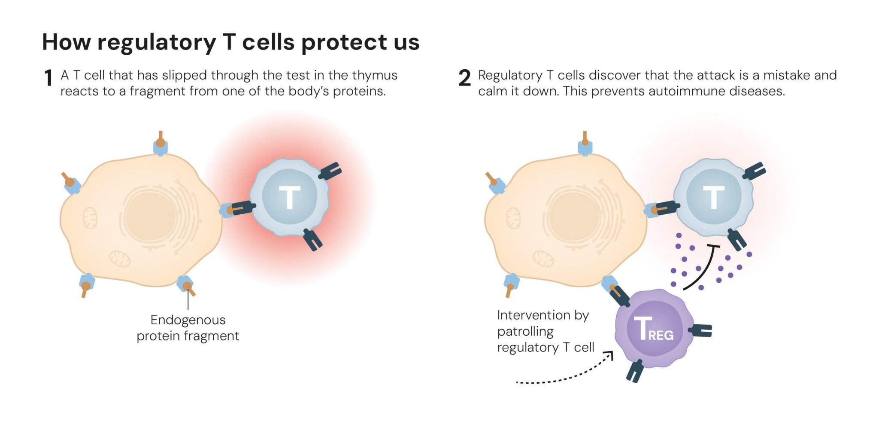
Regulatory T cells
Helper T cells: Patrol the body and alert other immune cells if there is an invader. [CD4+]
Killer T cells: Kill cell that have been infected. [CD8+]
Regulatory T cells: Calm the immune system by releasing cytokines. [CD25+ and CD4+]
“Forkhead box P3”, FOXP3: A gene that controls the development of Tregs (as a transcription factor).
Mutations in this gene cause a severe autoimmune diseases.
Now there are several clinical trials to control, engineer, and use Tregs:
⬆ with IL-2 for atopic dermatitis, suppressing inflammation, celiac disease, transplants.
⬇ in mAbs/CCR8 for cancer

Slide 4
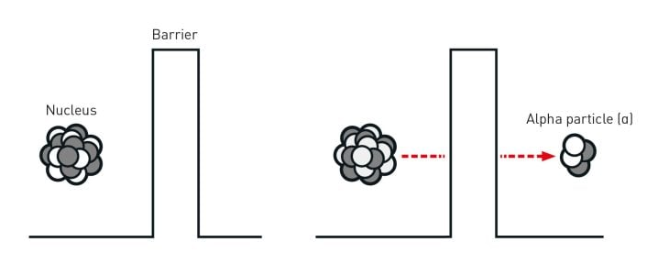
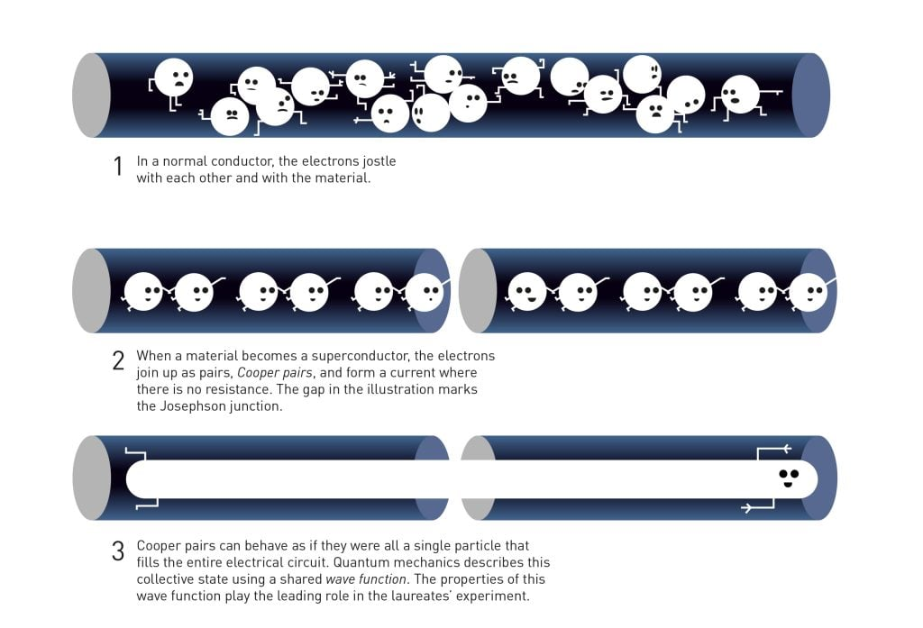
Macroscopic Quantum Tunneling
Quantum Mechanics: The science of tiny things like atoms, electrons, and photon
Quantum Tunneling: A particle passing through a medium. Usually only observable at microscopic scales.
The experiment: In an electric circuit between two superconductors, they placed a thin insulating barrier, forming a device known as a Josephson junction.
The current “tunneled” through it, but not as electrons…as a quantum state.
The electrons in the superconductors behave as one giant quantum particle.
This is the foundation for the development of superconducting qubits for quantum computing.

Slide 5
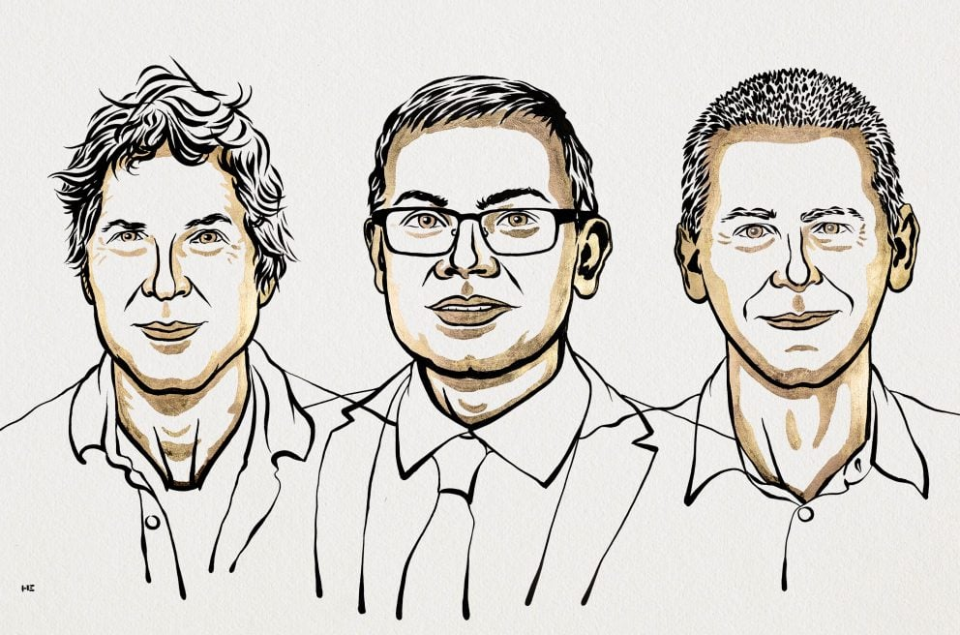
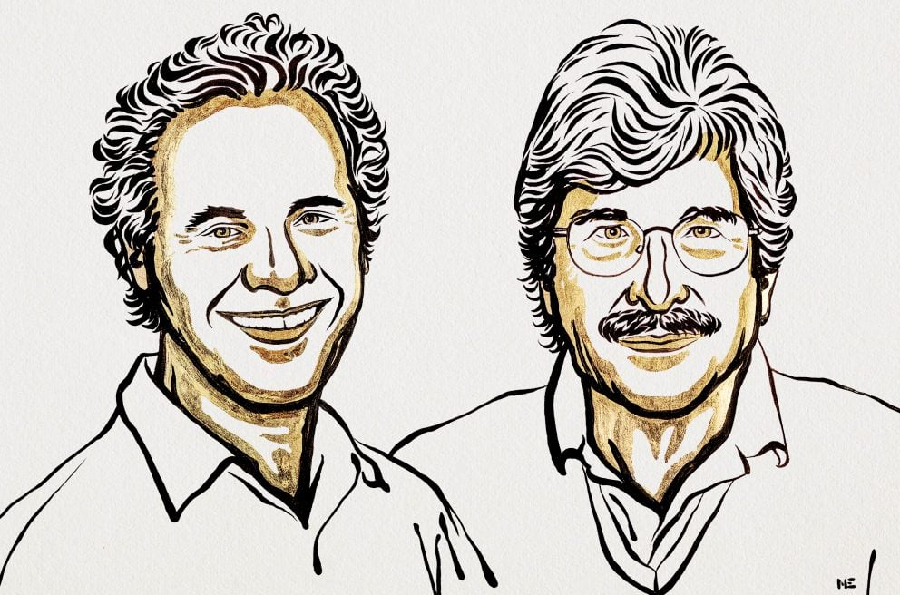
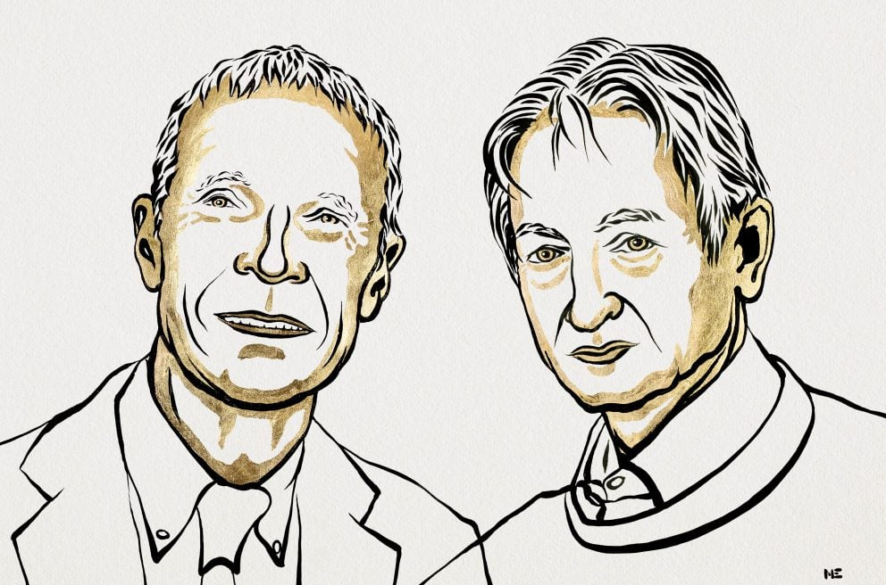
2024 Nobel Prizes!
Chemistry
David Baker - “for computational protein design”
Demis Hassabis and John M. Jumper - “for protein structure prediction”
Physiology or Medicine
Victor Ambros and Gary Ruvkun - “for the discovery of microRNA and its role in post-transcriptional gene regulation.”
Physics
John J. Hopfield and Geoffrey E. Hinton - “for foundational discoveries and inventions that enable machine learning with artificial neural networks.”

Slide 6
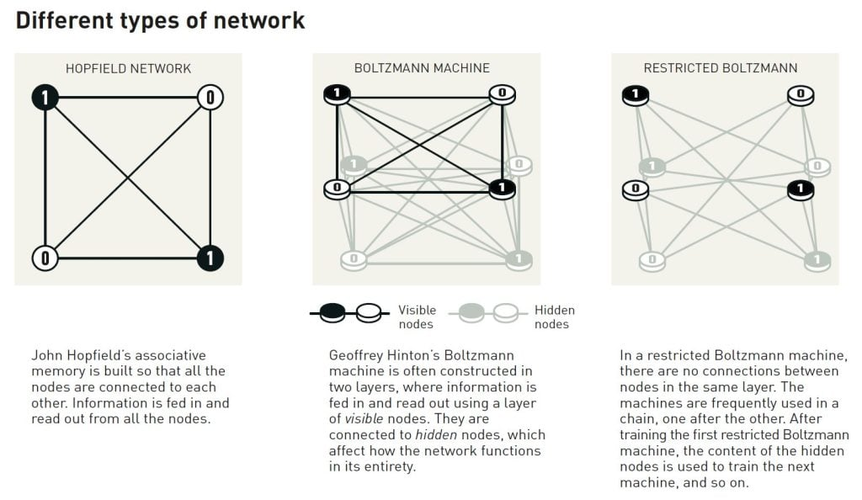
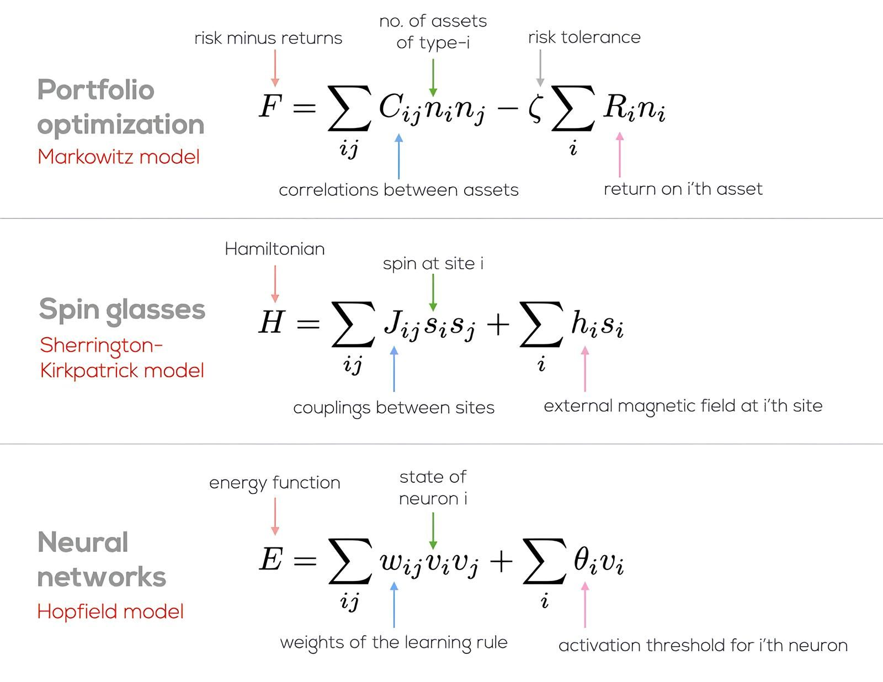
Physics? or AI?

Slide 7



















Some Azure Services
Functions
Batch
CycleCloud
Synapse
Databricks
Storage
Container Registry
Foundry
Web Apps
Virtual Machines
Data Factory
SQL DB
Container Instances
CosmosDB
Power BI
PostgreSQL
AI Services /
OpenAI
ML Studio
Kubernetes Service

